Slide 1
Customer Churn Rate Analysis
Reducing Churn, Improving Service, Enhancing Satisfaction
[ Noorjahan ]

Slide 2
PROBLEM STATEMENT
You are an analytical CRM (Customer Relationship Management) specialist hired by a bank to extract meaningful insights from various customer-related datasets. The bank aims to reduce customer churn, improve service delivery, and enhance customer satisfaction. They have provided you with datasets including customer demographics, transaction details, customer exit information, and active customer profiles.

Slide 3
Introduction
The bank is facing challenges in maintaining customer loyalty and aims to address issues related to customer churn.
The primary goals are to reduce customer churn, improve service delivery, and enhance overall customer satisfaction.
The bank has provided comprehensive datasets including:
- Customer demographics: Information about customers' age, gender, geography, etc.
- Transaction details: Records of customer transactions and financial activities.
- Customer exit information: Data on customers who have left the bank.
- Active customer profiles: Current active customers and their account details.
You analyze these datasets as an Analytical CRM specialist to extract meaningful insights and provide strategic recommendations.

Slide 4
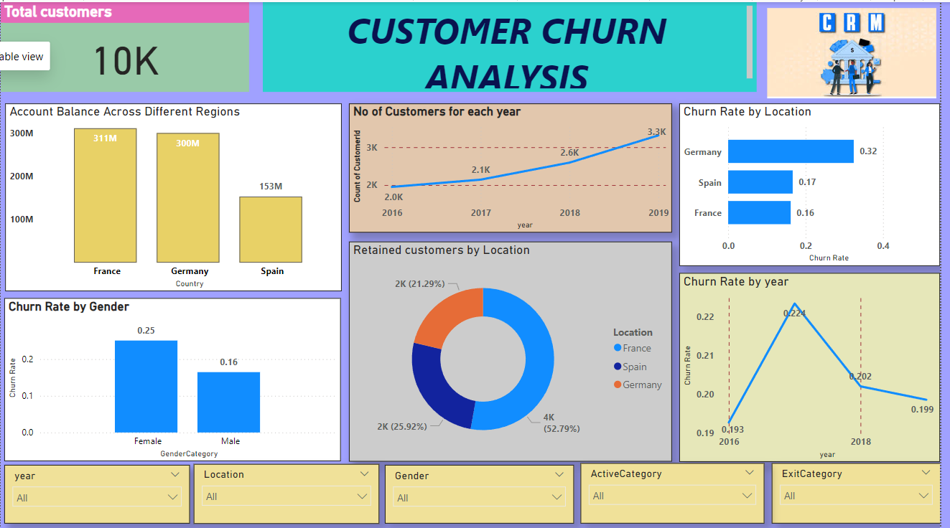
Data Exploration
Data Profiling: Checked the data types of all the columns where Bank-date-of-joining was incorrectly assigned a text data type. I used an update query to change the data type to Date.
Data Cleaning: For accurate analysis, check the null values in all the tables.
Data Visualization: For understanding patterns, trends, and outliers in our dataset. A good dashboard can answer questions and bring insights to the table immediately, rather than forcing users to plow through data and figure out what is important to them.
Here’s a glimpse of a dashboard created for this project.

Slide 5
Key Metrics
Total Customers
10K
Retained Customers
7963
Exit Customers
2037
Credit Card Holders
7055
Non Credit card Holders
2945
Active Members
4849

Slide 6
Objectives
IDENTIFY LOCATIONS
AND GENDER WHERE THE CHURN RATE IS MORE
PROPOSE MEASURES
TO RETAIN CUSTOMERS FROM CHURN
ANALYZING THE CUSTOMER SEGMENTS FOR POTENTIAL CHURN

Slide 7
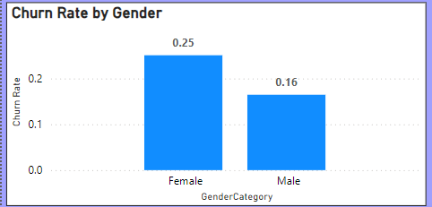
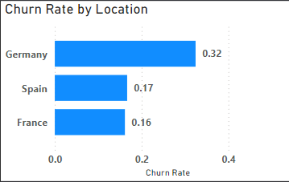
IDENTIFY LOCATIONS
AND GENDER WHERE CHURN RATE IS MORE
Insights: From the dataset's geography locations, Germany has a high churn rate compared to other countries. Female Customers Have a High churn rate compared to male customers

Slide 8
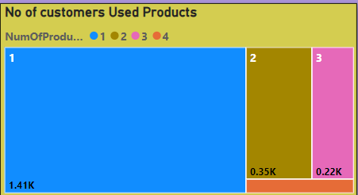
ANALYZING THE CUSTOMER SEGMENTS FOR POTENTIAL CHURN
Insights: Excited customers used only one product of the bank which makes a potential customer segment for churn.
Also, credit score comes in the poor category have highest churn rate which is 0.218 that could be a potential churn category.
category.

Slide 9
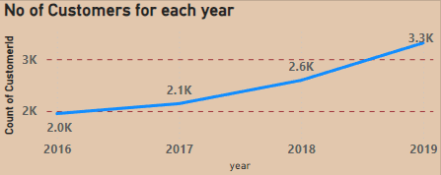
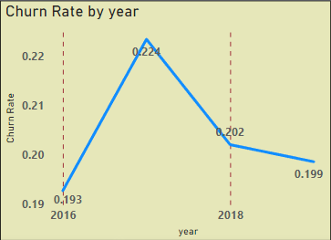
PROPOSE MEASURES
TO DECREASE CHURN RATE
Insights: The number of customers joining the bank increases year to year which is a good sign as well the churn rate also decreases year to year. Take necessary steps to increase the joining of customers every year from which we can decrease the churn rate. Also, focus on countries like Germany and France to take marketing measures to reduce churn rate as they have high churned customers 841 and 810 respectively.

Slide 10
Conclusion
Effective use of CRM analytics can significantly reduce customer churn, improve service delivery, and enhance customer satisfaction.
- The insights derived from the provided datasets offer valuable guidance for strategic decision-making.
- Implementing the recommended actions will enable the bank to meet customer needs better and foster long-term loyalty.

Slide 11
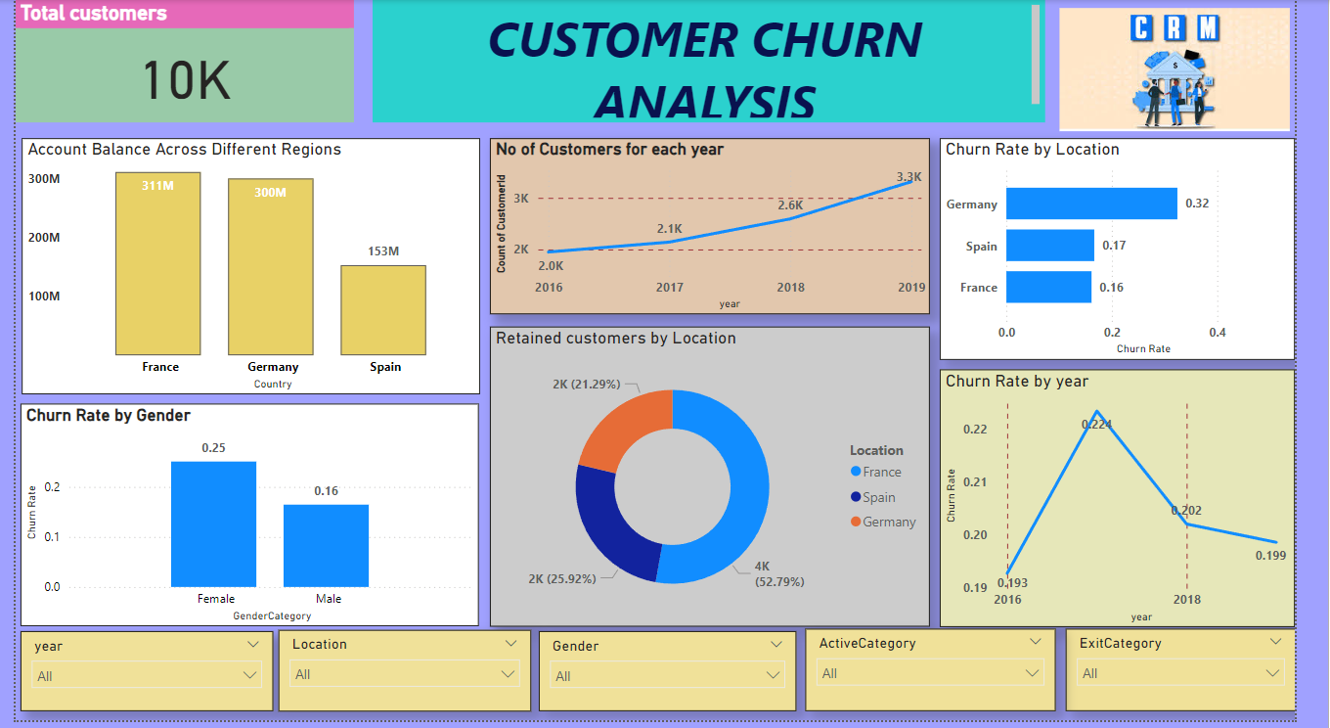

Slide 12
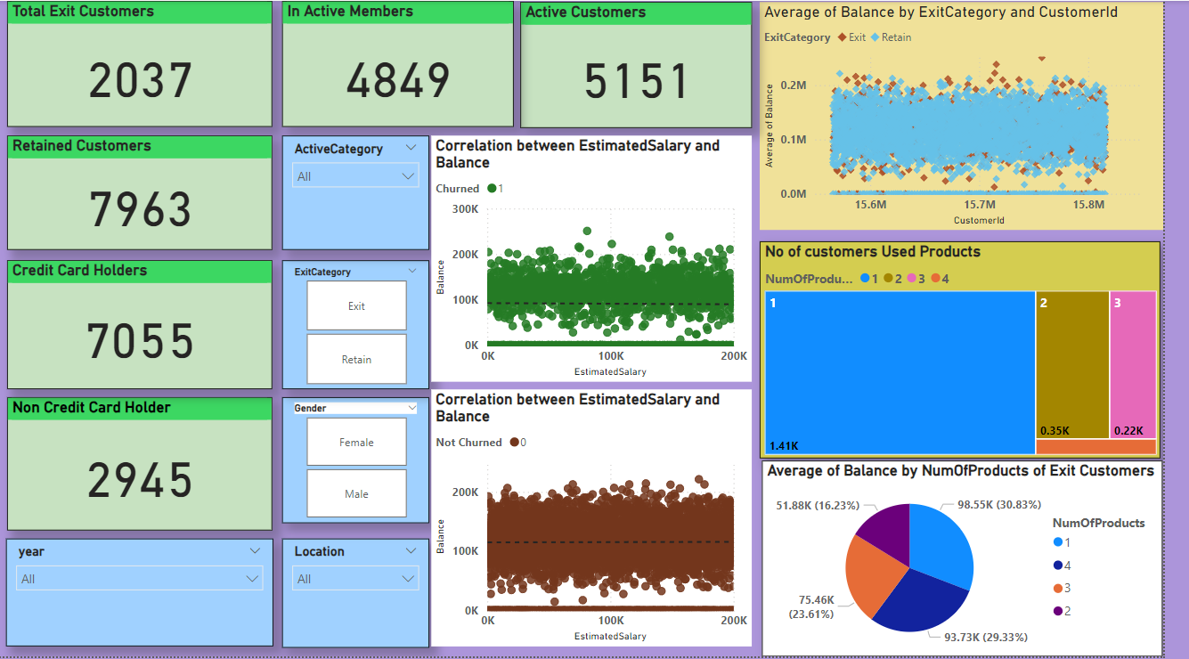

Slide 13
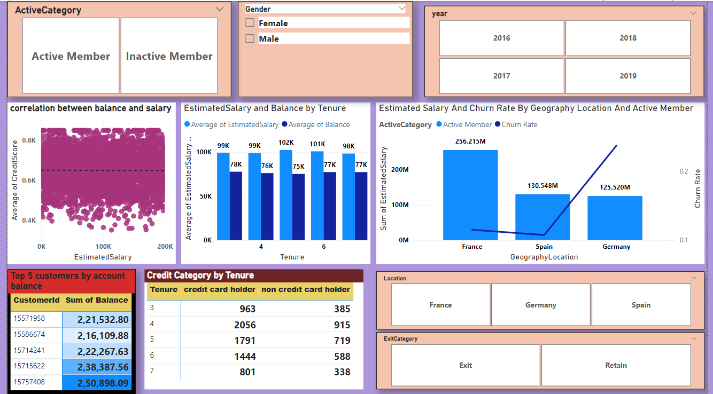

Slide 14
Thank You

